Slide 1
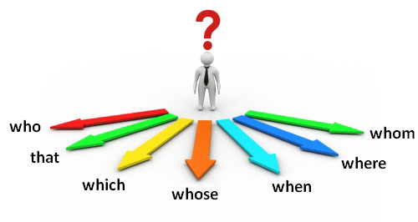
Relative clauses
Meaning and use
Relative clauses are used to give additional information about a noun, such as a person, place or thing. Relative pronouns introduce a relative clause. They include who for people, that and which for things, when for time, and whose to show possession.
http://www.bbc.co.uk/learningenglish/english/course/intermediate/unit-18/tab/grammar

Slide 2
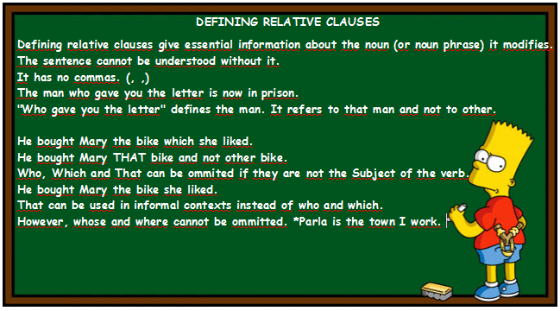
Relative clauses belong to one of two categories: defining relative clauses and non-defining relative clauses.
1. Defining relative clauses add essential information to a sentence.
The woman who found my wallet handed it in to reception.
The student whose dog has run away, has gone to look for it.
I remember the day when we first met.
These are the earrings that my mother gave me.
These clauses give essential information about the subject of the sentence. They define the person, time or thing that we are talking about. If we remove the clause, the sentence does not make sense.

Slide 3
2. Non-defining relative clauses add extra information to a noun or noun phrase.
My friend’s birthday, which was last weekend, was great fun.
My current girlfriend, who I love very much, calls me every night.
This extra information is not essential. If we remove the clause, the sentence still makes sense.. This type of clause is more common in written English.

Slide 4
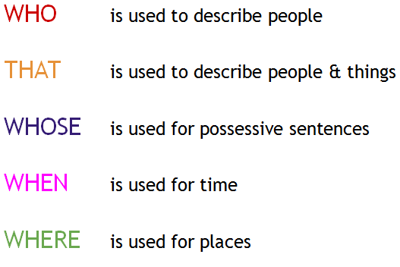
Form
Defining relative clauses are made with noun + relative pronoun + rest of clause.
A kangaroo is an animal which lives in Australia.
The man who came for lunch was my uncle.
Winter is a time when it sometimes snows.

Slide 5
Non-defining relative clauses are made in the same way. An important difference, however, between both types of clause is the use of punctuation. With non-defining relative clauses, we separate the clause with commas. We cannot use that in this type of clause.
My favourite food, which used to be Italian, is now Japanese.
Rachel, who we met yesterday, lives in this neighbourhood.
My car, which I bought seven years ago, needs replacing.
This shirt, which I bought last weekend, cost £50.
My best friend, who I met at university, is coming for dinner.

Slide 6
Add the phrase in brackets to the sentence using 'that' or 'who' and a relative clause:
She worked for a man (the man used to be an athlete)
They called a lawyer (the lawyer lived nearby)
I sent an email to my brother (my brother lives in Australia)
The customer liked the waitress (the waitress was very friendly)
We broke the computer (the computer belonged to my father)
I dropped a glass (the glass was new)
She loves books (the books have happy endings)
They live in a city (the city is in the north of England)
http://www.perfect-english-grammar.com/relative-clauses-exercise-1.html

Slide 7
Add the phrase in brackets to the sentence using 'that' or 'who' and a relative clause:
She worked for a man who used to be an athlete.
They called a lawyer who lived nearby.
I sent an email to my brother who lives in Australia.
The customer liked the waitress who was very friendly.
We broke the computer that belonged to my father.
I dropped a glass that was new.
She loves books that have happy endings.
They live in a city that is in the north of England.

Slide 8
Add the phrase in brackets to the sentence using a relative clause:
The man was late (Julie invited the man)
The doctor was sick (I wanted to see the doctor)
I wrote to the friend (you met the friend last week)
I met a girl (the girl was a doctor)
I went to the restaurant (I read about the restaurant in the newspaper)
I often buy cheese (the cheese is imported from Paris)
The hairdresser was very good (the hairdresser has red hair)
The nurse is in the office (the nurse treated my grandmother)
http://www.perfect-english-grammar.com/relative-clauses-exercise-4.html

Slide 9
Add the phrase in brackets to the sentence using a relative clause:
The man who/that Julie invited was late.
The doctor who/that I wanted to see was sick.
I wrote to the friend who/that you met last week.
I met a girl who/that was a doctor.
I went to the restaurant which/that I read about in the newspaper.
I often buy cheese which/that is imported from Paris.
The hairdresser who/that has red hair was very good.
The nurse who/that treated my grandmother is in the office.

Slide 10
Take note: replacing the relative pronoun
In informal communication, relative pronouns, such as who and when,are commonly replaced with that in defining relative clauses.
The woman that called last night was very polite.
Do you remember the time that you first met?

Slide 11
Take note: leaving out the relative pronoun
When using defining relative clauses in informal speech and writing, the relative pronoun can be left out completely if it refers to the object of the relative clause.
This is the shirt that I bought.
This is the shirt I bought.
The girl who I like isn’t here yet.
The girl I like isn’t here yet.
In non-defining relative clauses, the relative pronoun cannot be left out.

Slide 12
Which sentences can have the relative pronoun removed?
The man who/that Julie invited was late.
The man Julie invited was late.
The doctor who/that I wanted to see was sick.
The doctor I wanted to see was sick.
I wrote to the friend who/that you met last week.
I wrote to the friend you met last week.
I met a girl who/that was a doctor.
I went to the restaurant which/that I read about in the newspaper.
I went to the restaurant I read about in the newspaper.
I often buy cheese which/that is imported from Paris.
The hairdresser who/that has red hair was very good.
The nurse who/that treated my grandmother is in the office.

Slide 13

Take note: spoken English
The relative pronoun who is used when referring to people. However, in formal written and spoken English, if the pronoun refers to the object of the clause, we use whom instead.
My German teacher, whom I really admired, retired last year.
The woman whom I called this morning was my secretary.

Slide 14

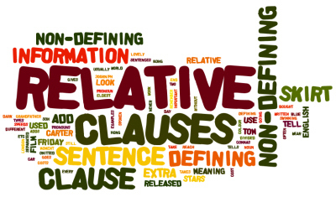
Let’s check… defining or non-defining: http://www.bbc.co.uk/learningenglish/english/course/intermediate/unit-18/session-2

